Slide 1
Estrous Detection

Slide 2
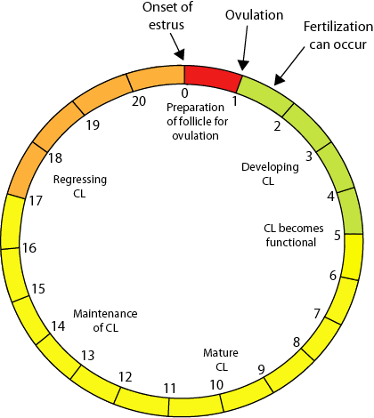
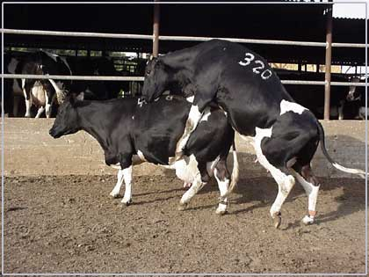
Estrus: The period of sexual excitement (Standing Heat) where the female is receptive to the male and will stand for mating
Estrous Cycle: The reproductive cycle of domestic animals. It is measured from the beginning of one estrus to the beginning of the next (ie. 21 days)

Slide 3
Factors effect to estrus cycle
1-nutrition (inactive ovaries)
2-season(long day and short day breeder )
3- lactation
4- age of animals
5-Disease uterine and cervix (endometritis , pyometra …….)
6- endocrine glands disorder (cystic ovary)
7- Temperature
8- animals transport
9- type of animals work
10 – general disease
11- breed of animals

Slide 4
Season – Most studies have reported a depression in estrus expression during extreme temperatures, either hot or cold. The inability to have a period of recovery from high temperatures during the day has also been reported to negatively affect estrus behavior. Heavy rain, strong wind, and high humidity also reduce or suppress estrus behavior.
Nutrition – Loss of body reserves (negative energy balance) can negatively affect estrus expression. The presence of mycotoxins, especially vomitoxin and zearalenone, reduce or suppress estrus expression.

Slide 5
Housing – The type of floor surface affects estrus behavior. Duration of estrus and number of mounts were longer (13.8 versus 9.4 hours) and greater (7 versus 3.2 times) on dirt than on concrete surfaces. Covering a concrete grooved floor with perforated rubber mats improved the ability of cows to express normal behavior activity.
Days in milk – Silent heat (more correctly, silent ovulation), is common at the first ovulation after calving. Progesterone released from the corpus luteum (CL), formed after the silent ovulation, appears to favor estrus expression during the next cycle.

Slide 6
detection Estrous
Detection of estrus : is one of the most critical components of a successful breeding program. Accurate and consistent detection of estrus is necessary to ensure insemination occurs near the time of ovulation and to identify open females. Errors in detection of estrus reduce reproductive performance and increase herd non-productive days
Opens days : the period stared from parturition to fertilization (90-100 days) Its composed of (uterine involution + estrous cycle )
Uterine involution : return the anatomy and physiology of uterus to after parturition (40-50 days)
Calving intervals : it’s the period stared from one parturition to other parturition (360 days) its composed of(open days +pregnant time)
Repeat breeder : repeat the estrous cycle more three times after insemination but without fertilization so require treatment)

Slide 7
Important of estrous detection
1 – to decrease number of repeat breeder in cow
2 – decrease number service per conception
3 – decrease number of open days
4 – decrease number of calving intervals
5 – decrease number of culling percentage due to reproductive reasons

Slide 8
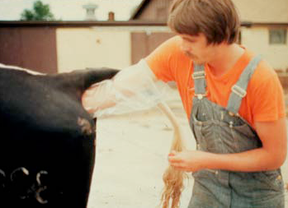
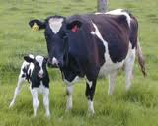
Estrus detection to
Decrease open days decrease calving interval

Slide 9
Estrus detection
A - Visual aids
1- herd man (owner)
2-video recording
3-sheep dogs (wolf dogs)
4- Teaser
A - culled cow (virilism )
B – bull ( vasectomy , penis deviation , penectomy , epidily mectomy )
5- Tail paint
6- Chin bell
7- ovascan

Slide 10
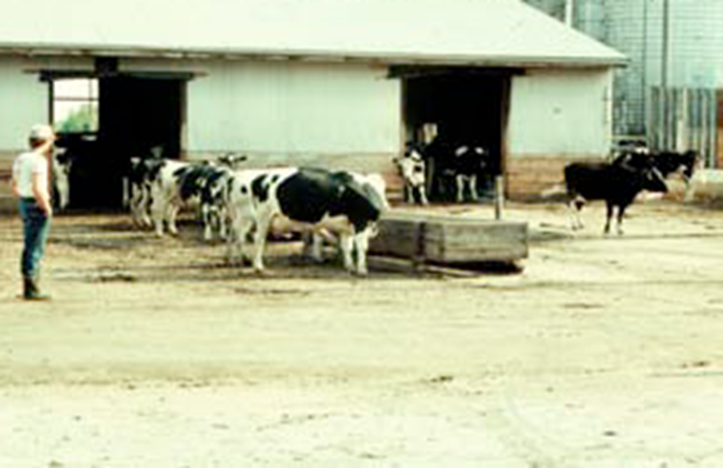
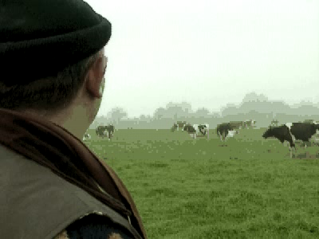
Herd man(owner) to estrous detection
1 – skill detection estrous behavior
2 - must be three time before milking
3 –length time observation must be 30 minute

Slide 11
Standing to be mounted is the only true primary sign that a female is in heat. However, a variety of behavioral changes that occurs before and during estrus indicates that a cow or heifer may have normal estrus functions. Secondary signs of estrus include: swollen vulva, mucous discharge, nervousness, riding others in heat, head rubbing and separation from the herd. Scientists report that secondary signs of estrus may begin 4 to 48 hours before primary signs. As the onset of estrus approaches, estrous cyclic cattle will stand still and allow other cows or bulls to mount. Record all cattle in heat and make note of those showing secondary signs of heat. Cattle showing secondary signs of heat may stand to be mounted during the subsequent detection periods.

Slide 12

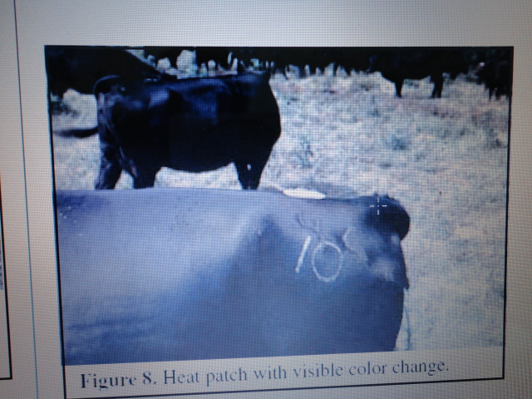
Video recording to estrus detection

Slide 13


Sheep dogs (wolf dogs) to estrus detection it smell pheromone from vaginal discharge

Slide 14
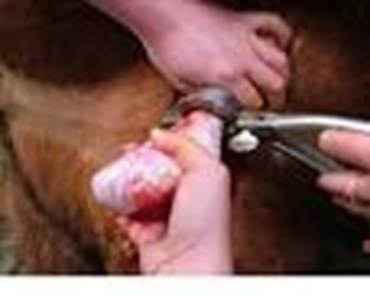
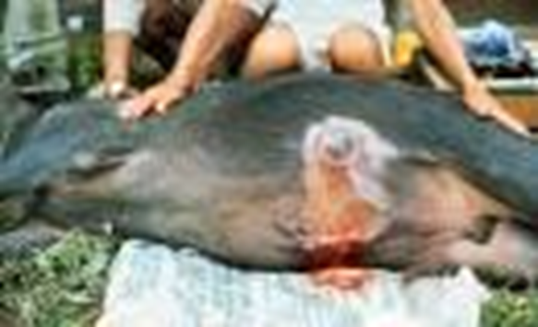
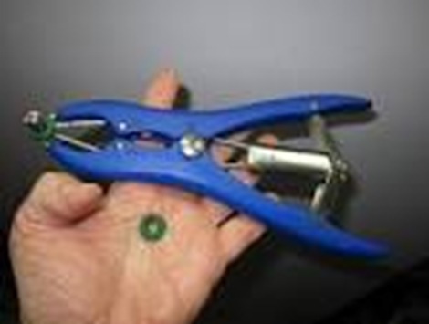
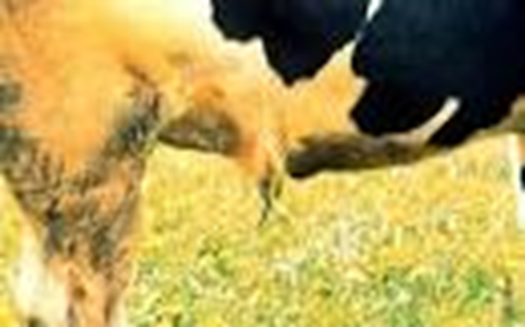
Preparation teaser to estrus detection
Vasectomy
Penis deviation

Slide 15
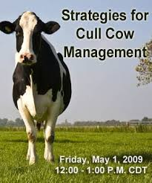
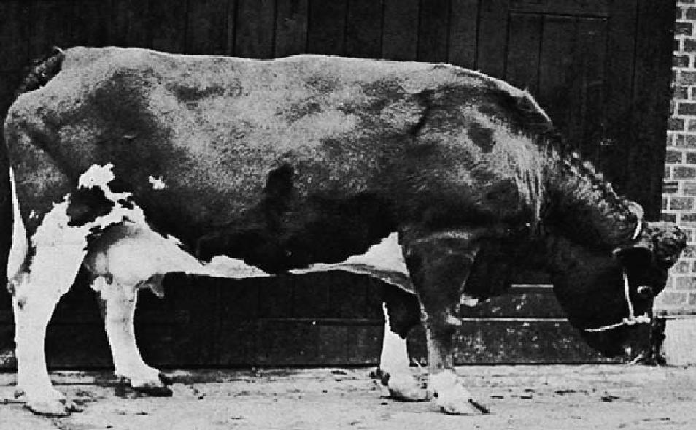

Preparation teaser to estrus detection
Luteal cyst cows (virilism )
Androgenized cows

Slide 16
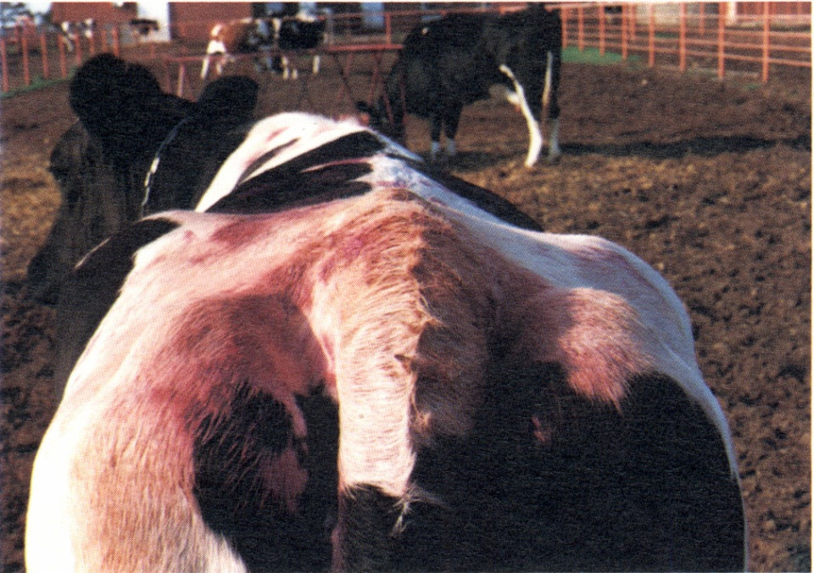
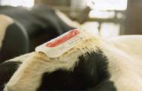
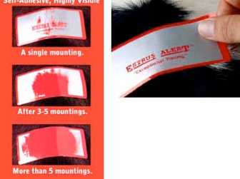

Tail paint to estrus detection

Slide 17
You simply glue a detector onto the skin covering the tail bone of each cow. Glue is provided with the detectors. When a cow wearing a heatmount is mounted by a herdmate, constant pressure from the brisket of the mounting animal turns the detector red - bright enough to be seen from a distance. Three seconds of constant pressure is needed to release enough dye to turn the detector red identifying a true heat. This leaves a visible indication that th

Slide 18
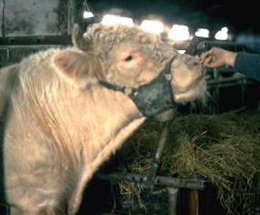
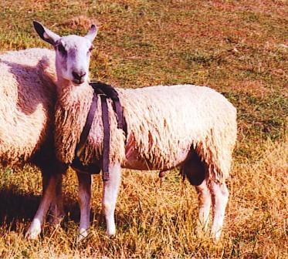
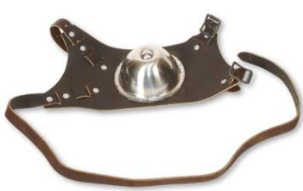
Chin - Ball to estrus detection

Slide 19
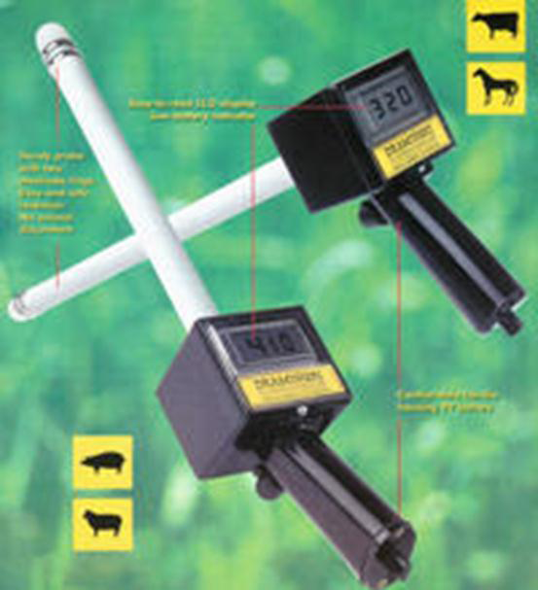
Visual aids to estrus detection
Ovascan to estrus detection

Slide 20
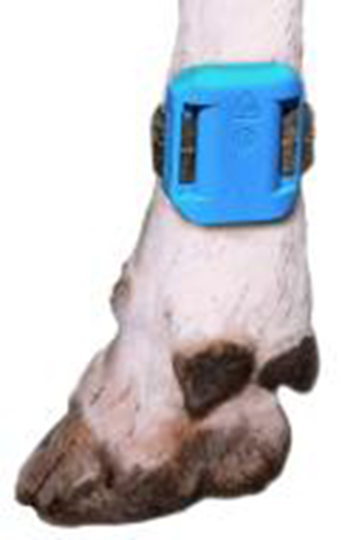
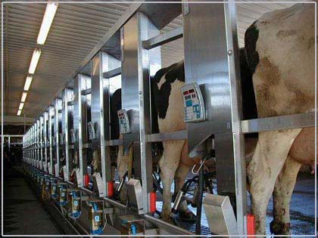
Pedometer to estrus detection
This device is used along with a computer to determine how far an animal has walked. Animals in heat are usually restless and may walk long distances.

Slide 21
Computerized Estrous Detection
Current computerized estrous detection devices (radiotelemetry) available to producers can be used effectively and efficiently.
Patches equipped with transmitters are glued to the tail head of the cow. When mounting activity begins, the transmitter is depressed and a signal sent to a receiver.
Mounting activity data includes the transmitter number, date, time and duration of the mount.

Slide 22
1. Transmitter with pressure
sensitive button on top
3. The receiver accepts the mounting
activity signal from the transmitter
Receiver
~1/2 mile range
2. Mounted onto cow’s rump
using a patch and adhesive
)))))))))))))))))))))))))))))))))
4. Information is transferred to
computer for processing by
HeatWatch software.

Slide 23
B- non visual aids
1- Cervical vagina mucus
A- Viscosity (decrease)
B- Ferning( ferning pattern –Crystallization -ARBORIZATION )
C -Biochemical change (glucose increase )
2- vaginal change
A- ph decrease
B- Electrical resistance cytology decrease
C- Thermal conductivity increase
D- Vaginal biopsy
3- Hormonal changes in blood and urine ( estrogen ,progesterone)
4 -rectal palpation to predict estrus
5 - estrus synchronization

Slide 24




Estrus detection in mare

Slide 25
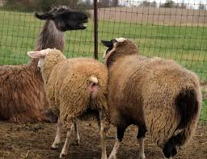
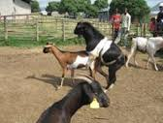
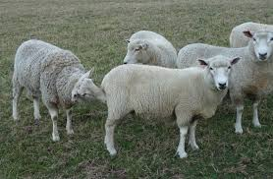
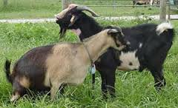
Estrous detection in ovine

